Slide 1
Learning Outcomes
This presentation will ...
Review the CSS Box Model
Review "normal flow" of HTML
Configure float with CSS
Create two-column page layouts using CSS
Configure navigation in unordered lists and style with CSS
Configure fixed, relative, and absolute positioning with CSS
float_yls.html & .css
yls.jpg
lighthouse_basic.html & .css
lighthouse.html
lighthouseisland.jpg
lighthouselogo.jpg
exercises 4 & 5

Slide 2
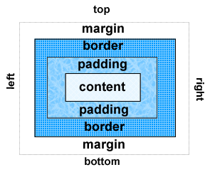
The Box Model
Content
Text & web page elements in the container
Padding
Area between the content and the border
Border
Between the padding and the margin
Margin
Determines the empty space between the element and adjacent elements

Slide 3
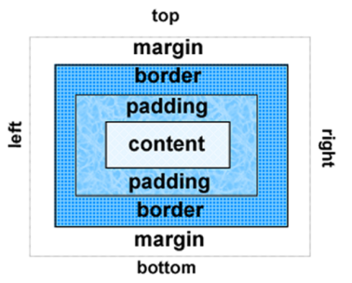
Configure Margin with CSS
The margin property
Related properties:
margin-top, margin-right, margin-bottom, margin-left
Configures empty space between the element and adjacent elements
Syntax examples
h1 { margin: 0; }
h1 { margin: 2em 5em; }
h1 { margin: 10px 30cm 20in; }
h1 { margin: 2% 3% 0 3%; }
What do these examples mean?
Notes:
All
Top-Bottom Right-Left
Top Right-Left Bottom
Top Right Bottom Left

Slide 4
Normal Flow
Browsers by default display elements in the order they are coded in the web page document
block elements
Nested:
<div>This is
the outer
box...
<div>This
is the inner
box...
</div>
</div>
In Sequence:
<div>This is the
first box… </div>
<div>This is the
second box… </div>
CSS provides properties to control placement of elements

Slide 5
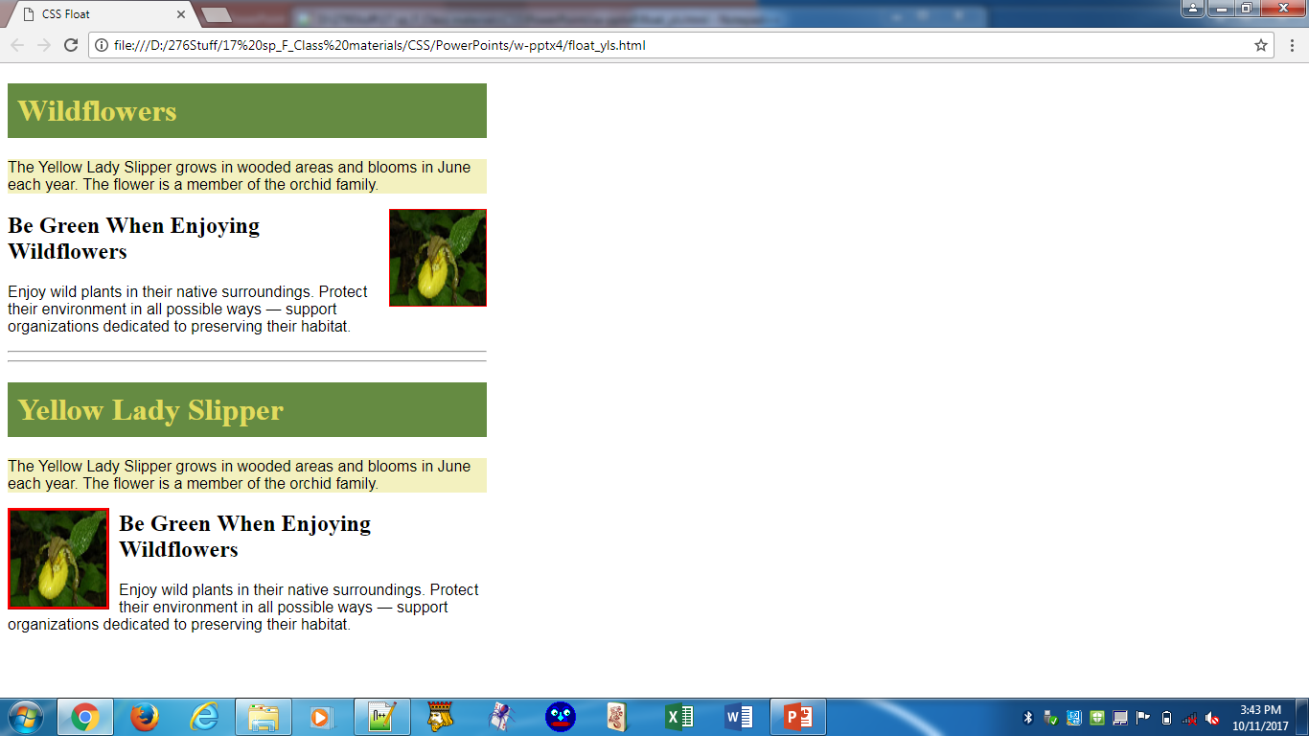
float Property
Causes elements to seem to “float" on the right or left side of the parent element. In this case, a p and a img element are in a div container element.
applied to img
…
#yls {float:right;
margin: 0 0 5px 5px;
border: 1px solid #ff0000;
}
.float { float: left;
margin-right: 10px;
border: 3px ridge #ff0000;
}
…
Run float_yls.html. Open in Notepad++ and note the code sequence: p before img. Reverse those elements (2 instances) and re-run.

Slide 6
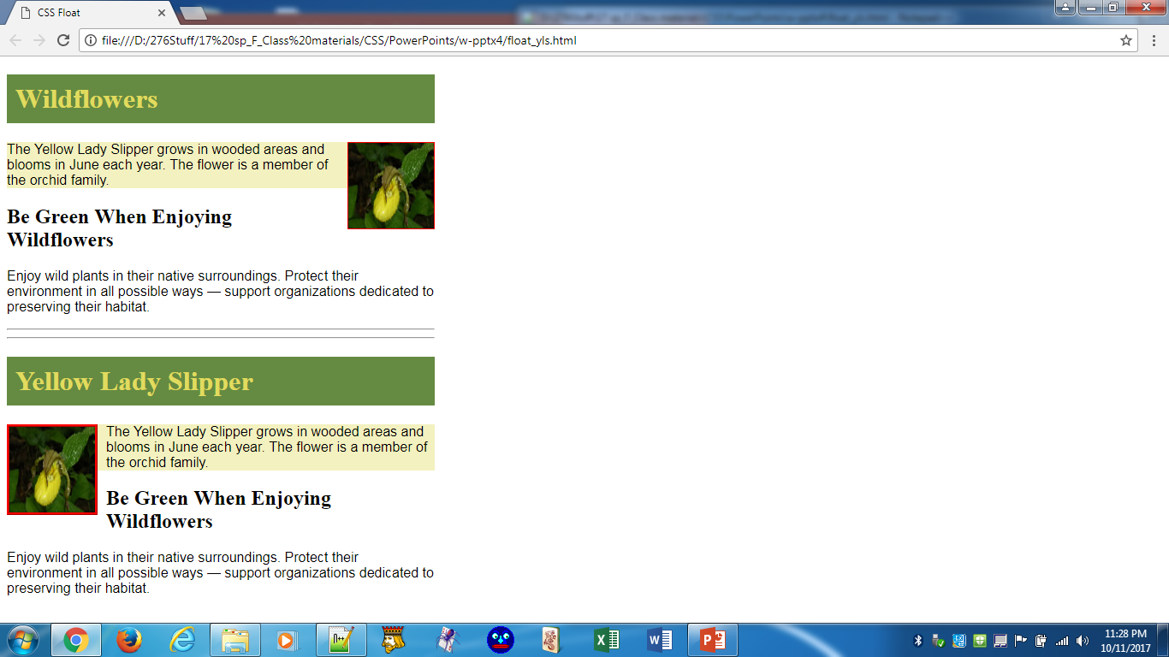
float Property, cont.
Code sequence of elements:
p before img
img before p
p is a block element; img is inline; both are in a div (block).

Slide 7
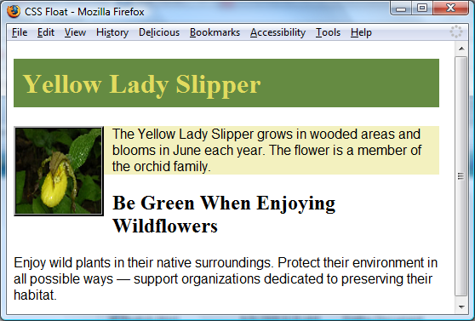
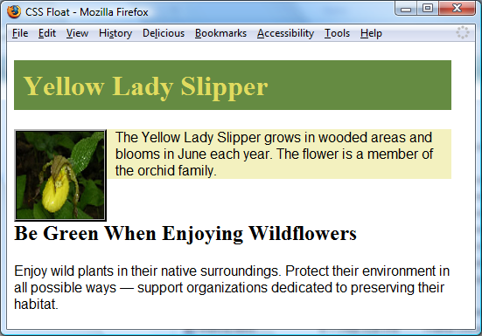
clear Property
The h2 text displayed in normal flow.
Used to “clear” or terminate a float
Values are left, right, both
h2 {clear: left; } applied to the h2. Now the h2 text displays AFTER the floated image.
Add the h2 element code to CSS. In float_yls.html, (img before p & float: left). Run.

Slide 8
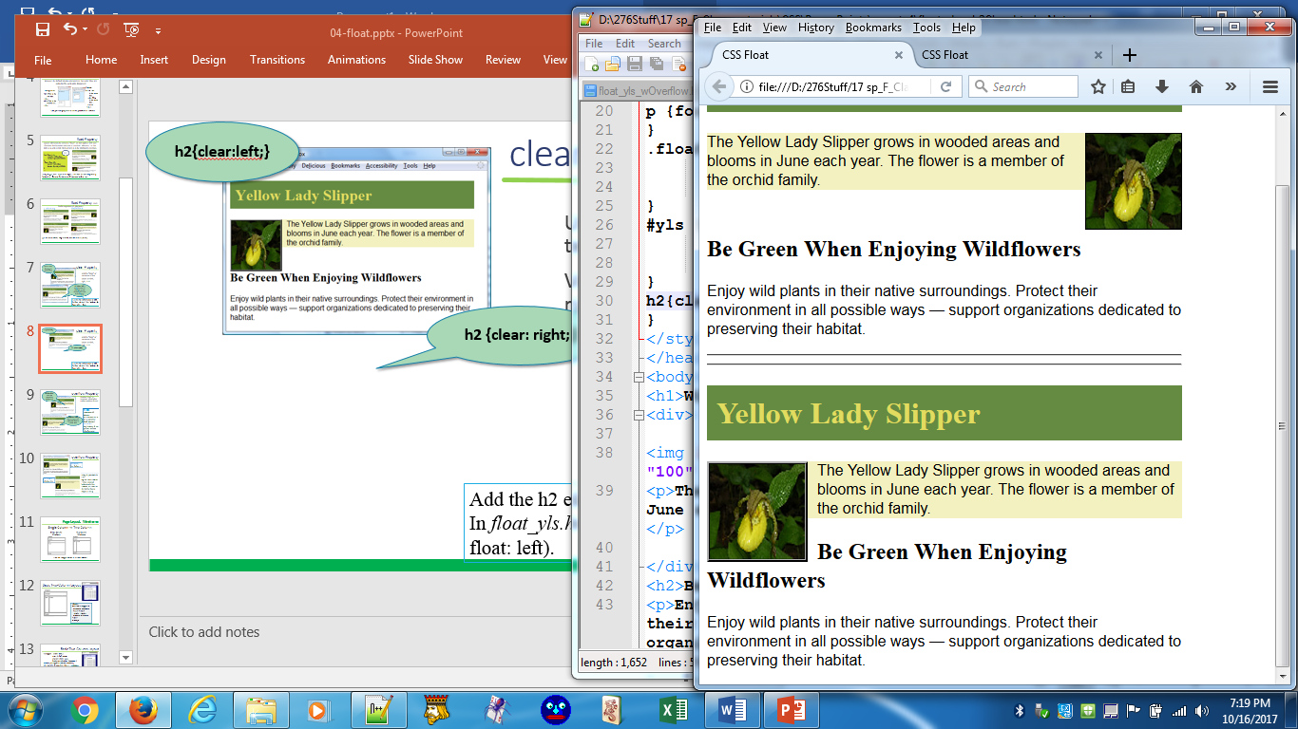
clear Property
h2{clear:left;}
Used to “clear” or terminate a float
Values are left, right, both
These are both float:left. The opposite effect occurs with a float:right. Thus, if you have a float:left, you probably want to clear:left and for a float:right, clear:right. However, this is not an absolute.
h2 {clear: right;}

Slide 9
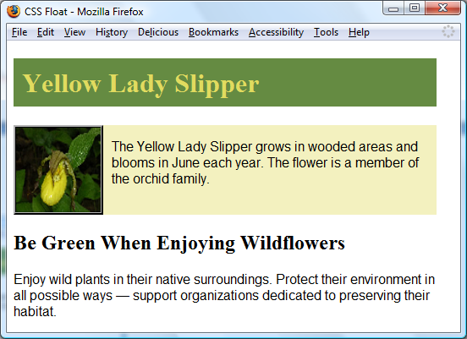
overflow Property
h2{clear:left; } does not extend the background.
Overflow “clears,” or terminates, a float before ending a container element
IN CSS:
--comment h2 element
--Add over-flow to div (a container block element)
IN HTML:
img before p & run (reverse and see what happens)
{overflow: auto; } Now background extends & there is a blank after.

Slide 10
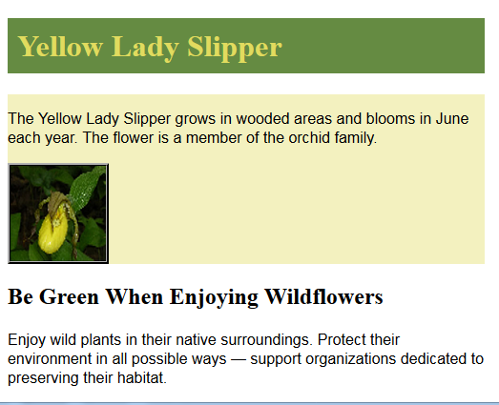
overflow Property
IN HTML:
img before p
--img & p are both in a div
--p is a block element
--when rendered before the in-line element, the float:left for the img has no impact on the p
IN HTML:
p before img

Slide 11
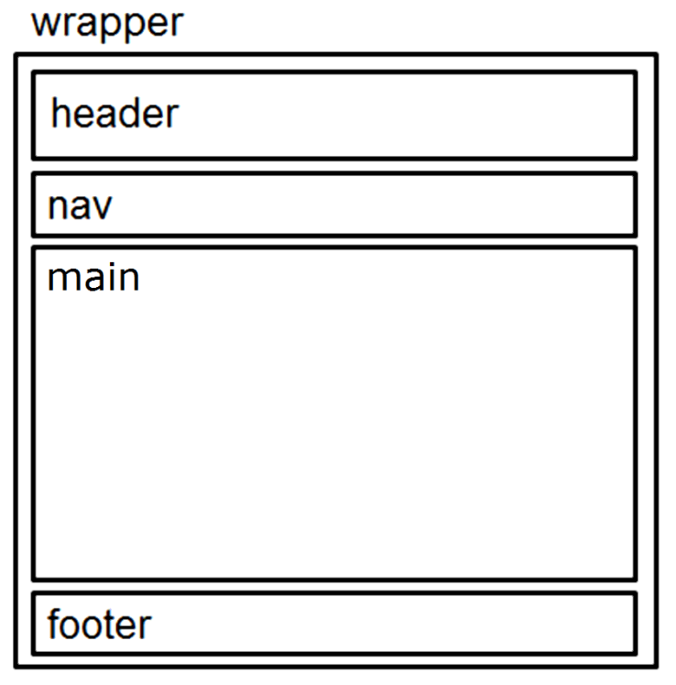
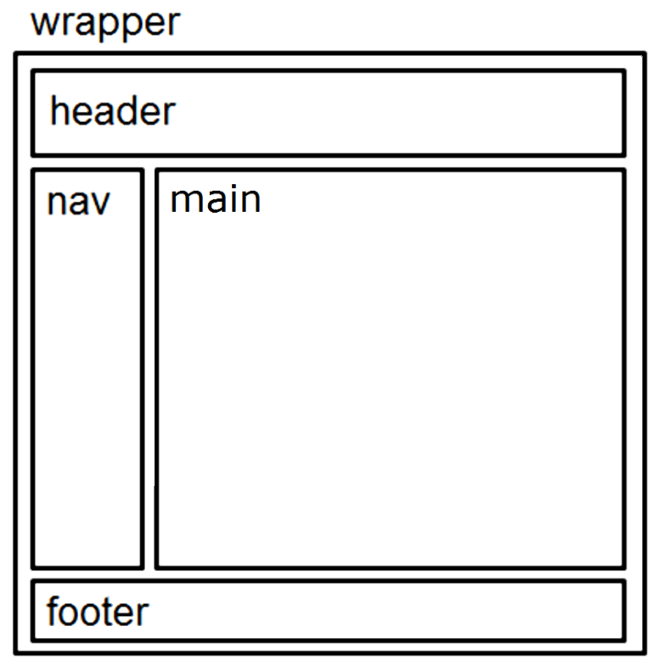
Page Layout: Wireframe
Single Column -> Two Column
Single Column Wireframe
Two Column Wireframe
body
body
(div)
(div)
Note the wrapper around all of the elements.
Notes:
Using the header, nav, main, footer sections provides more divisions without having to use so many div's

Slide 12
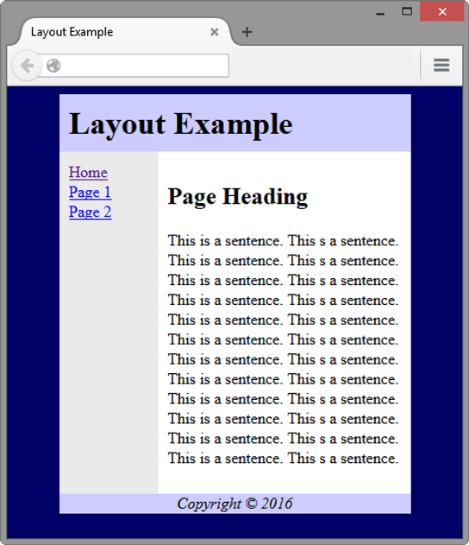
Basic Two-Column Layout
<body>
<div id="wrapper">
<header> <header>
<nav> </nav>
<main> </main>
<footer> </footer>
</div>
</body>

Slide 13
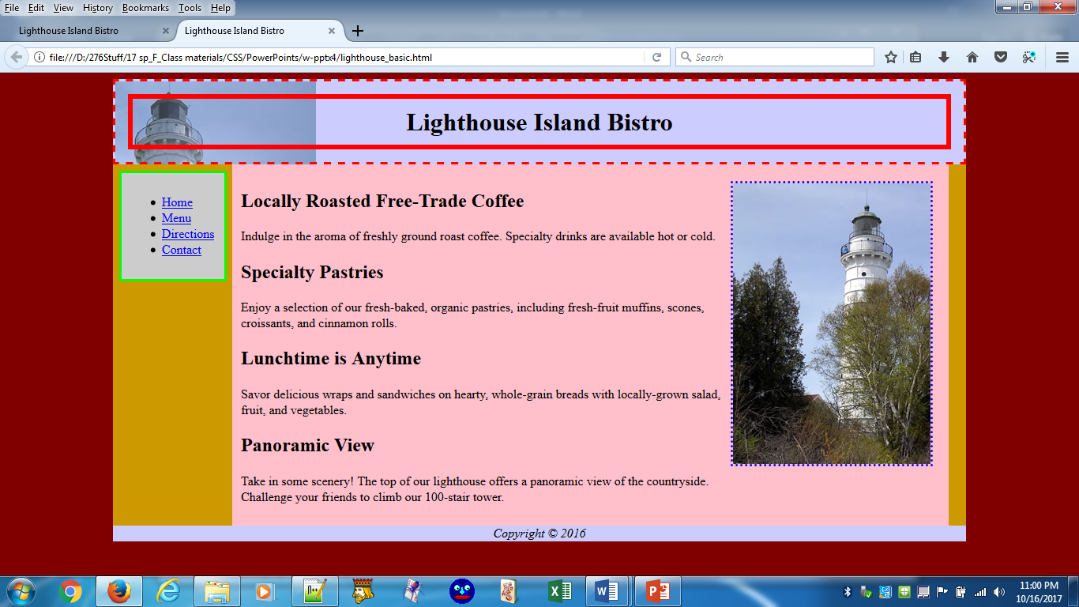
Basic Two-Column Layout
<body>
<div id="wrapper">
<header> <header>
<nav> </nav>
<main> </main>
<footer> </footer>
</div>
</body>
Open lighthouse_basic.html
Let's dissect
Float left
Clear right
Float right

Slide 14
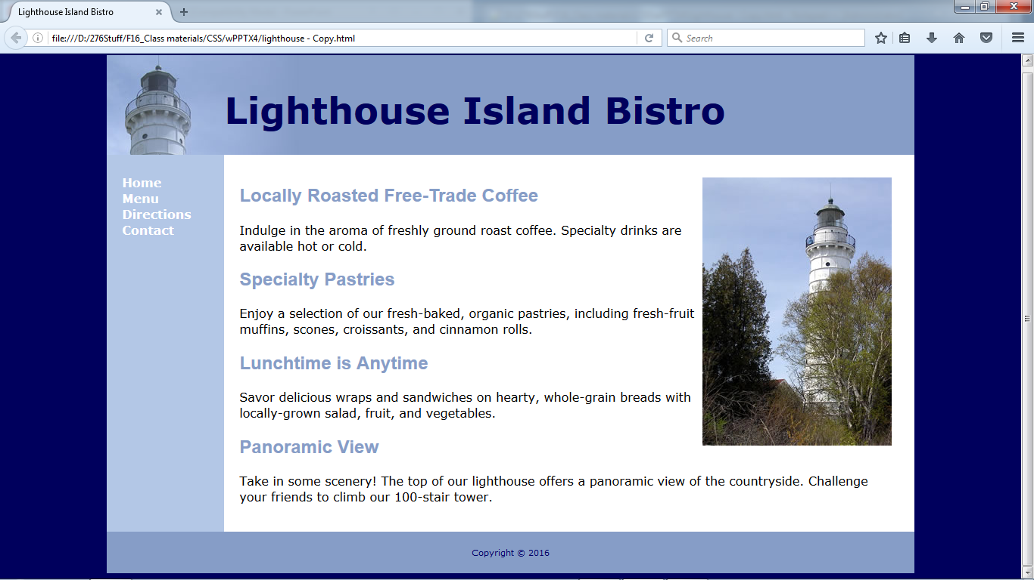
CSS Page Layout
By tweaking just a few things, our demo file looks like the following:
Open lighthouse.html and take a look.

Slide 15
Vertical navigation
This was in the Lighthouse example, but to emphasize:
<nav>
<ul>
<li><a href="index.html">Home</a></li>
<li><a href="menu.html">Menu</a></li>
<li><a href="directions.html">Directions</a></li>
<li><a href="contact.html">Contact</a></li>
</ul>
</nav>
CSS removes the list markers and underline:
nav ul { list-style-type: none; }
nav a { text-decoration: none; }

Slide 16
Horizontal Navigation
<nav>
<ul>
<li><a href="index.html">Home</a></li>
<li><a href="menu.html">Menu</a></li>
<li><a href="directions.html">Directions</a></li>
<li><a href="contact.html">Contact</a></li>
</ul>
</nav>
CSS removes the list marker, removes the underline, adds padding, and configures the list items for inline display.
nav ul { list-style-type: none;}
nav a { text-decoration: none;
padding-right: 10px; }
nav li { display: inline; }

Slide 17
CSS display Property
Configures how and if an element is displayed
display: none;
The element will not be displayed.
display: block;
The element is rendered as a block element – even if it is actually an inline element, such as a hyperlink.
display: inline;
The element will be rendered as an inline element – even if it is actually a block element – such as a <li>.
To support HTML5 elements in older browsers add this CSS statement:
header, nav, main, footer, aside {display: block;}

Slide 18
CSS image Property
Decorative Images can be designated using CSS
As always, a selector, ID, class, etc. is required in addition to the image source. Note that in CSS, "url(path/file_name)" is required, and a repeat property may be necessary.
Example:
h1{background-image: url(../images/leaves.jpg);
background-repeat: repeat-x; }

Slide 19
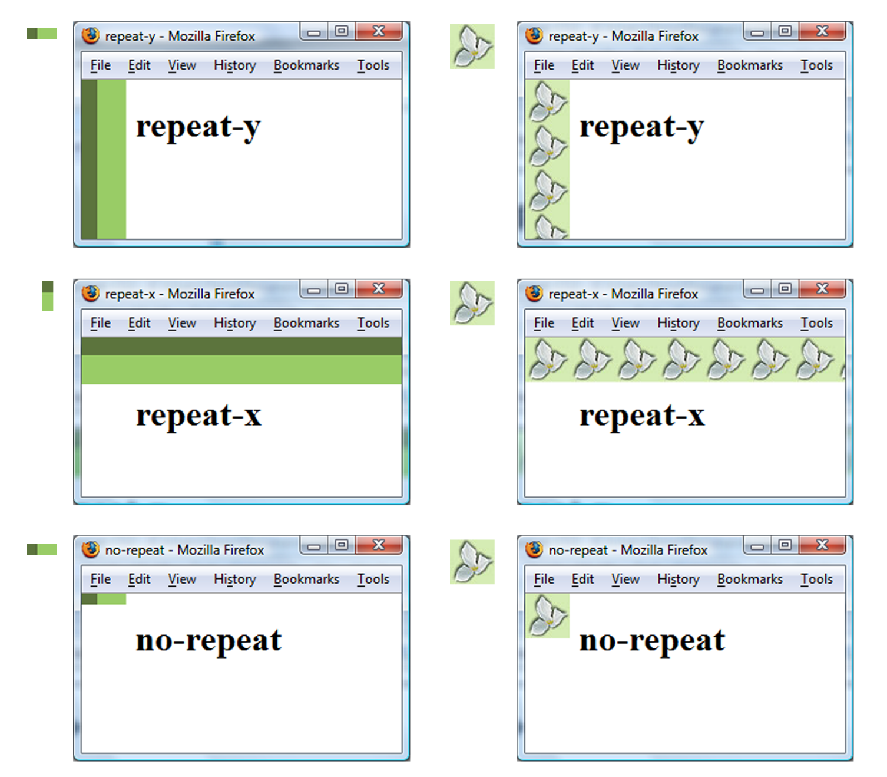
CSS background-repeat Property

Slide 20

Using background-repeat
trilliumbullet.gif:
h2 { background-color: #d5edb3;
color: #5c743d;
font-family: Georgia, "Times New Roman", serif;
padding-left: 30px;
background-image: url(trilliumbullet.gif);
background-repeat: no-repeat;
}

Slide 21
Your Turn!
Open the exercise 4 docx file and follow instructions.
The exercise will provide practice using the float element (along with others) in a 2-column page layout.

Slide 22
ARIA Landmark roles
Accessible Rich Internet Applications: HTML role Attributes
are intended to increase the accessibility of web pages.
The role attribute may have the following values (among others):
banner (header)
banner contains the prime heading or internal title of a page.
navigation
navigation indicates a collection of items suitable for navigating the document or related documents.
Complementary or note (aside)
secondary indicates that the section supports but is separable from the main content of resource.
main
main acts as the main content of the document.
contentinfo (footer)
contentinfo has meta information about the content on the page or the page as a whole.
skip to content
goes directly to main section
https://www.youtube.com/watch?v=ZaF2Ba-HALE
Notes:
The "Skip to Content" in the header element of the "Wildflowers" page is also an ARIA element.
Will use others when we discuss forms.

Slide 23
ARIA Landmark roles -- "how to"
banner (header)
<header role="banner">
navigation
<nav role="navigation">
complementary (aside)
<aside role="complementary">
main
<main role="main">
contentinfo footer)
<footer role="contentinfo">
skip to content
In header section add…
<span><a href="#content">Skip to Content</a></span>
And in main, add…
<main id="content" role="main" >
Notes:
The "Skip to Content" in the header element of the "Wildflowers" page is illustration of that ARIA element.
Will use others when we discuss forms.

Slide 24
Semantic Elements in HTML5
A semantic element describes its meaning to both the browser and the developer. Non-semantic elements like <div> and <span> have no intrinsic meaning, which makes it impossible for search engines to identify the correct web page content. Semantic elements like <header> <footer> <nav> <section> <aside> do have intrinsic meaning, which makes searches easier and brings a Semantic Web closer.
<section>
a thematic grouping of content, typically with a heading
<article>
specifies independent, self-contained content
<aside>
defines content aside from the content in which it is placed (like a sidebar)
<details>
Defines additional details that the user can view or hide
<figure> and <figcaption>
<figure>
<img src="lake.jpg" alt="Lake" width="304" height="228"> <figcaption>Fig1. - Bass Lake, Indiana.</figcaption> </figure>
Notes:
According to the W3C, a Semantic Web: "Allows data to be shared and reused across applications, enterprises, and communities."

Slide 25
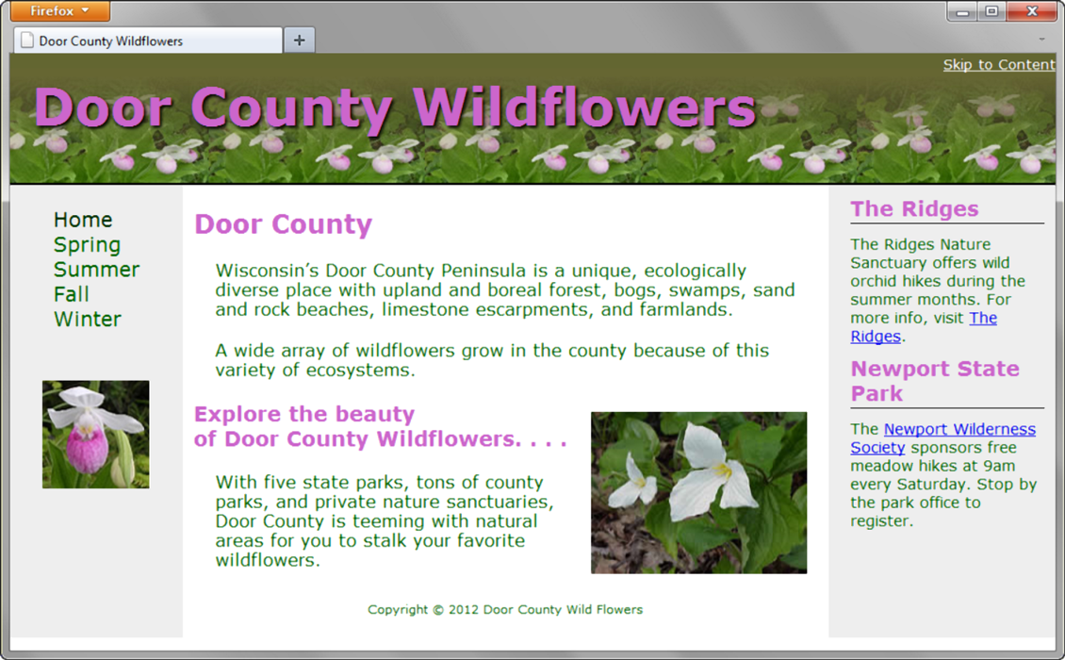
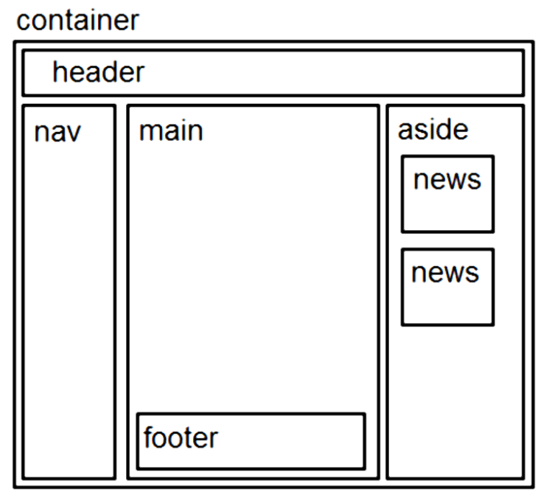
Three Column Page Layout
aside is an HTML5 semantic element
ARIA element
A common web page layout consists of a header across the top of the page with three columns below: navigation, content, and sidebar.

Slide 26


Three Column Page Layout, cont.
HTML Coding Sequence:
Body
Background color if desired
div for wrapper (container) background & text color, font typeface, and a minimum width:960px;
header
background image, height, etc.;
left-column (nav)
float: left; width:150px;
right-column content (aside)
float: right; width: 200px;
center column (main)
Uses the remaining screen room
after the floating columns display
margin: 0 210px 0 160px;
footer – clears the nav & aside floats
clear: both;

Slide 27
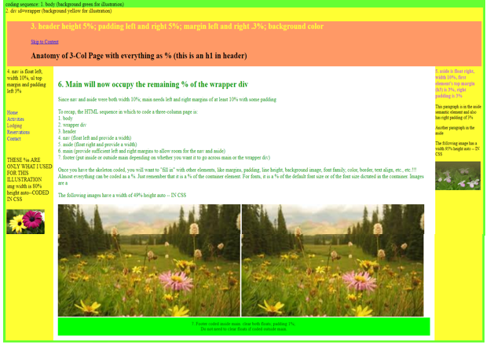

Slide 28
CSS Debugging Tips
-Manually check syntax errors
-Use W3C CSS Validator to check syntax errors
--http://jigsaw.w3.org/css-validator/
-Configure temporary background colors
-Configure temporary borders
-Use CSS comments to find unexpected renderings
--/* the browser ignores this code */
-Don’t expect your pages to look exactly the same in all browsers!
-Be patient!

Slide 29
Your Turn!
Open the exercise 5 docx file and follow instructions.
The exercise will provide practice using the float element (along with others) in a 3-column page layout.

